Slide 1


MISSIONAL LISTENING
JOINING GOD IN OUR COMMUNITIES
Notes:
This was the presentation from Simon Mattholie on day 2 of the conference – Sally has made a few notes for Ruth Leigh in the notes pages.
Missional Listening was something that Simon championed with the charity Rural Ministries and this had greatly influenced Sally in the way she approach the Growing in God in the Countrysie Project. This was the Project running the LoveRural conference as part of its work.

Slide 2
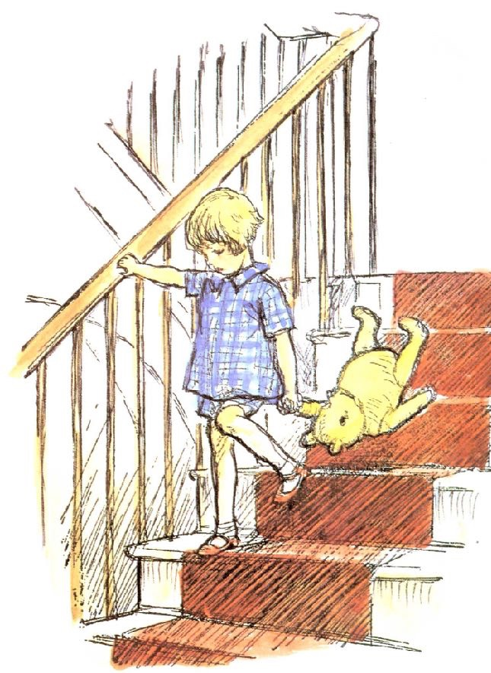
A lesson from
Winnie-the-Pooh
Here is Edward Bear, coming downstairs now, bump, bump, bump, on the back of his head, behind Christopher Robin. It is, as far as he knows, the only way of coming downstairs, but sometimes he feels that there really is another way, if only he could stop bumping for a moment and think of it.
Notes:
This quotation caused a laugh. As people identified with following models of ministry as if they were paint by numbers.

Slide 3
Tell, Teach, Tend, Transform & Treasure
What is mission?

Slide 4

Strategy
≠
mission
Notes:
Simon parodied his first appointment – when he had a great strategy – but it didn’t work – he hadn’t listened to the people among whom he was called to serve.

Slide 5
missio Dei
vs.
missio Ecclesia
Mission is more of a posture than a project

Slide 6

A listening problem?
“As Christians, we turn up with our pre-fabricated model of church. We know exactly what ministries or programs we’re going to offer, and we place them in our neighbourhood or community, whether they want it or like it or not.”
Michael Frost
“A kind of listening with half an ear… is only waiting for a chance to speak.”
Dietrich Bonhoeffer
Notes:
Churches are called to listen to their own neighbourhoods– and based their actions on what God ways through and in these contextsrather than emulating “Successful” churches elsewhere

Slide 7
Cultural context
Post-Christendom > Post-secular
75-year story ending
Can no longer expect people to simply come and listen
Where is your church still living in the old story?

Slide 8
Theology of listening
Genesis 1: Creation hears and obeys
Shema: “Hear, O Israel”
Mark 4: Parable of the soils
Genesis 28:16 “Surely the Lord is in this place…”

Slide 9
Missional listening defined
Listen to not listening for
Look for where God is ‘leaking’
Fan into flame the image of God in others (Debra Hirsch)
Start from blessing (Gen 1-2) not brokenness (Gen 3)

Slide 10


Potatoes vs. Lettuce
Notes:
Story of a pastor who planted lettuce in his new garden – but it didn’t come off because the pastor who had just preceded him had already planted potatos which cane up and overcame the lrruce… moral was liste to find out what has gobe bbefore

Slide 11
Practical tips
Be present
Ask questions
Partner, don’t fix
Reflect
Act
Review

Slide 12
Our current moment
Spiritual curiosity among Gen Z
Science embracing supernatural
Longing for meaning and purpose
Opportunity for Jesus-centred communities
Notes:
The call to meet this current moment was an emerging theme throughout the conference

Slide 13
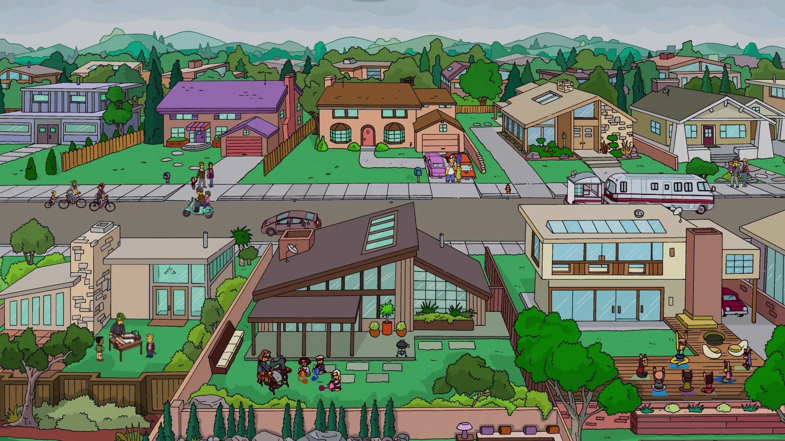
Where might God already be at work in your community – and what would it look like to join him there?

Slide 14
Not ‘what can we do?’ but ‘what is God doing here, now?’
CLOSING CHALLENGE

Slide 15
Closing prayer

Slide 16

Thank you
minister@clarebaptistchurch.org.uk
M: 07932467655

